Slide 1

Chloe
Melinda
Shimea
Rachel
VR/AR X EDU - TEAM 5
CS 147 - Assignment #5
B
I
U
MetaGym
Lo-Fi Prototype +
Initial User Testing

Slide 2
1
1.
EXPLORING DESIGN IDEAS
PRESENTATION
OVERVIEW
2.
MOBILE + VR LO-FI PROTOTYPES
3.
USABILITY TESTING + ANALYSIS

Slide 3
2
OUR PRODUCT: METAGYM
[ Mission Statement ]
[ Value Propropistion ]
Make working out fun and motivating by feeling present with a community and learning from live experts.
Get fit with anyone, anywhere

Slide 4

Page 6
EXPLORING
DESIGN
IDEAS

Slide 5
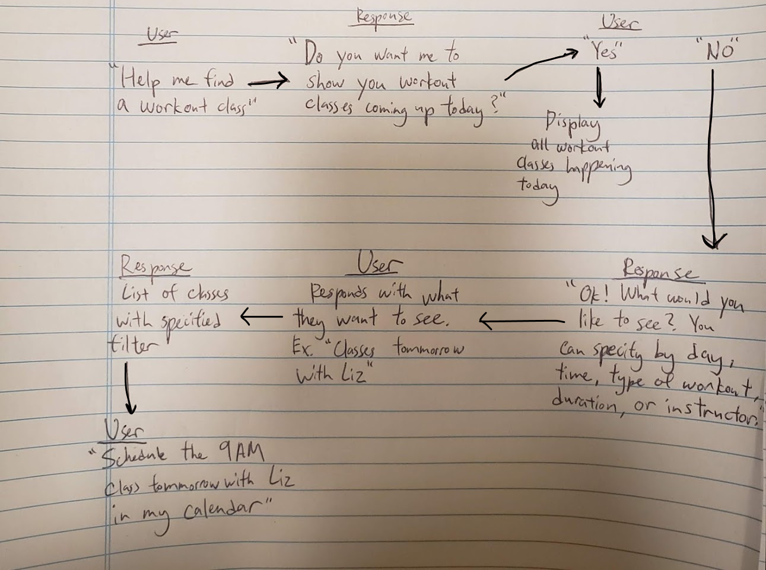
VOICE COMMAND

Slide 6
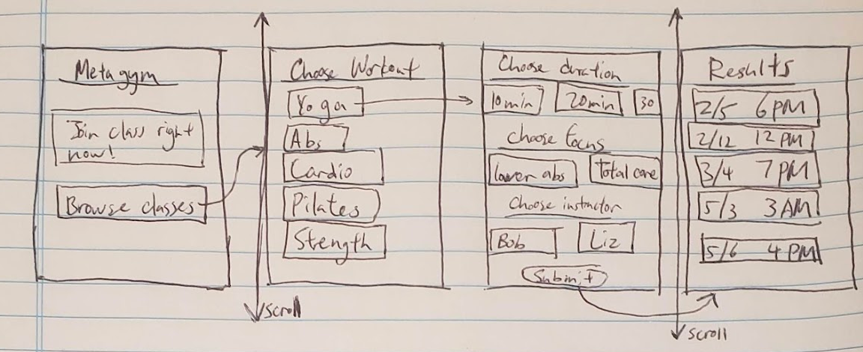
MOBILE

Slide 7
INTERFACE SELECTION & RATIONALE
While asking a voice assistant to help users find classes could feel more personal, we felt that browsing through classes on a smartphone would be more intuitive and would allow users to find the classes they are trying to find more quickly. We ultimately believed that the greater functionality on a mobile device trumps the extra personalization a voice-based system would have.
We decided for on a mobile app interface for browsing and planning workout classes

Slide 8
Page 6
LO-FI
PROTOTYPES

Slide 9



Prototyping Tools Used

Slide 10
Mobile Prototype
TASK 1:
BROWSE & PLAN
FITNESS CLASS

Slide 11
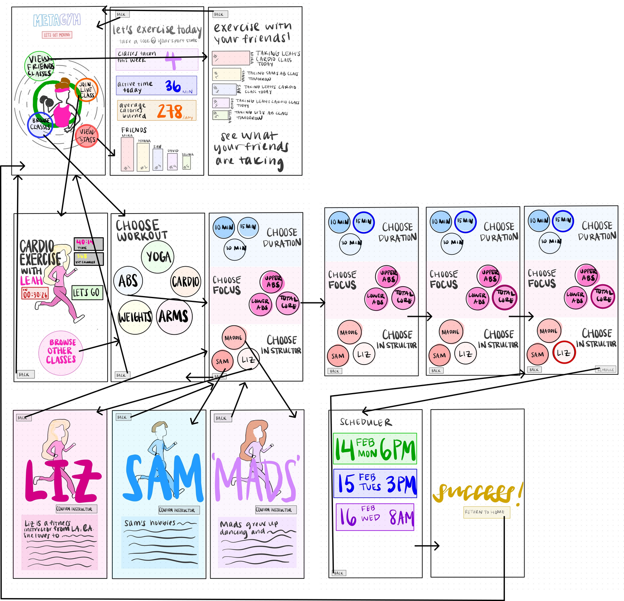
Browse & Plan Fitness Classes

Slide 12
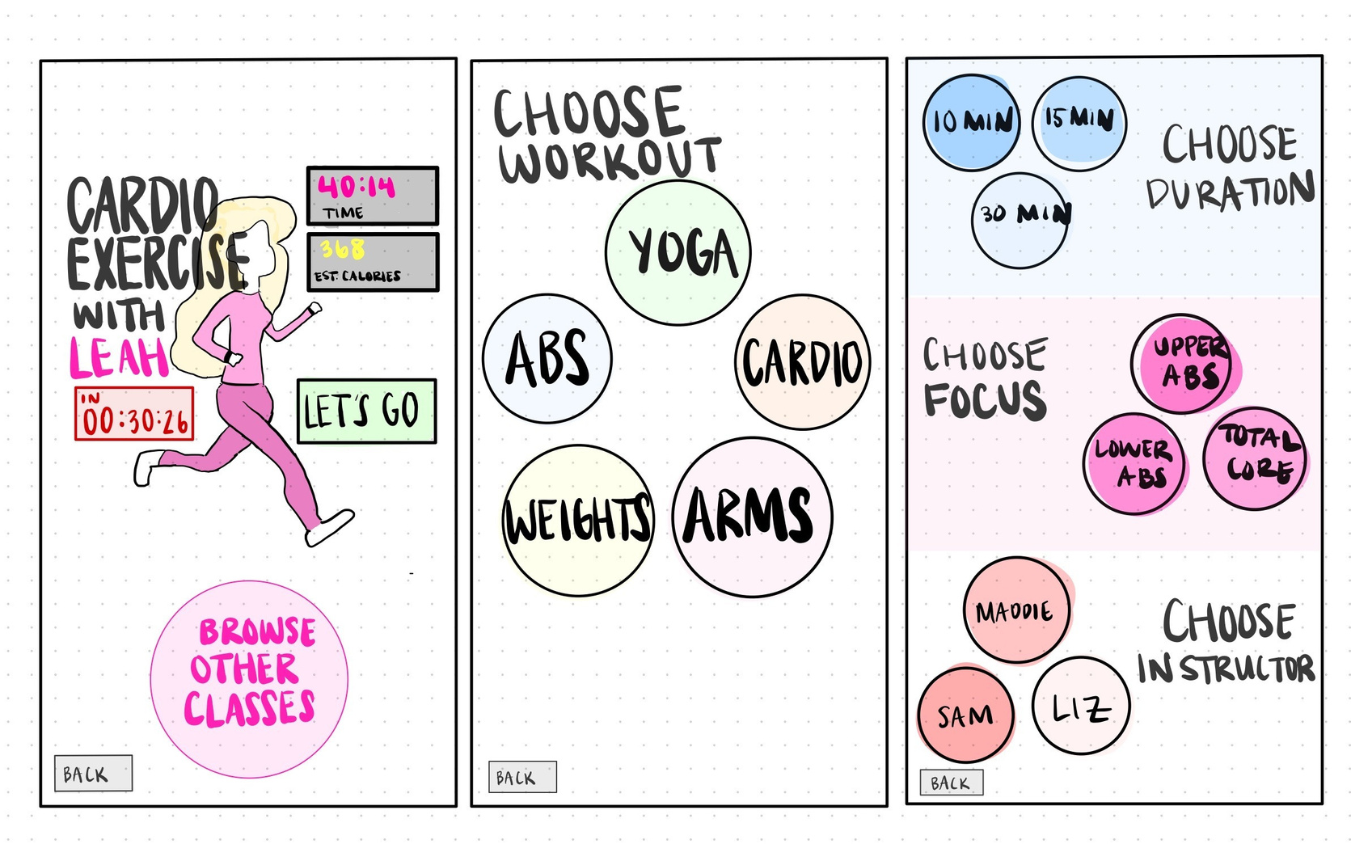
Browse & Plan Fitness Classes
CHOOSE WORKOUT + DURATION/FOCUS/INSTRUCTOR

Slide 13
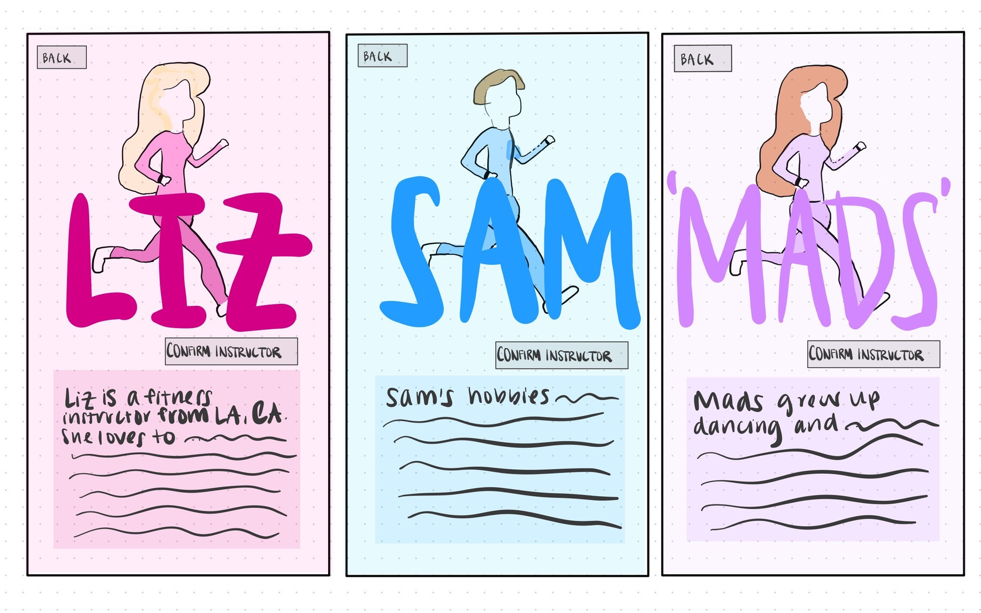
Browse & Plan Fitness Classes
INSTRUCTOR BIOS

Slide 14
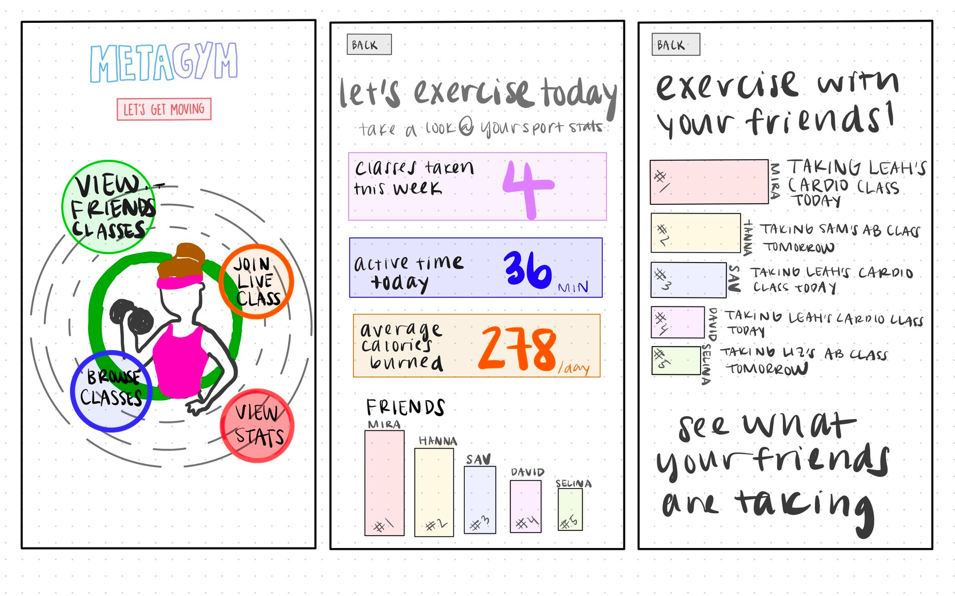
Browse & Plan Fitness Classes
TRACK PERSONAL PROGRESS + FRIEND ACTIVITY

Slide 15
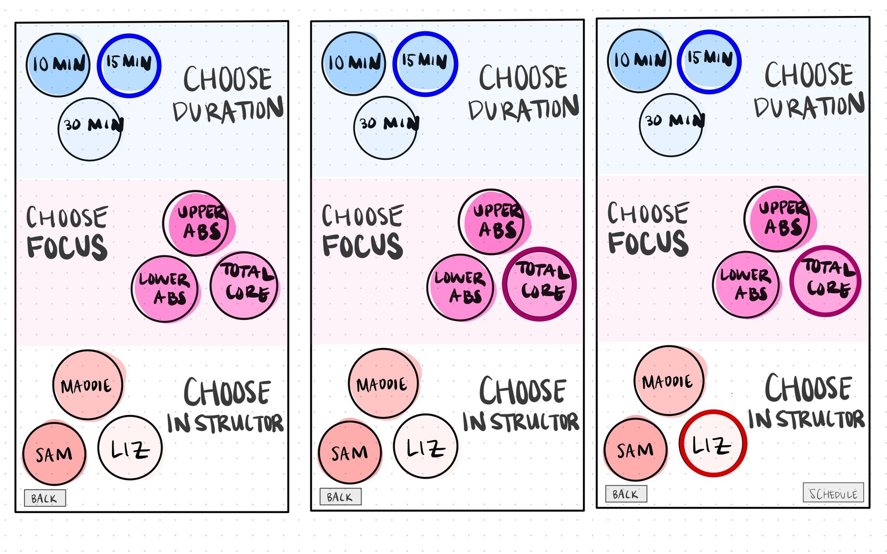
Browse & Select Fitness Classes
CHOOSE DURATION, FOCUS, AND INSTRUCTOR

Slide 16
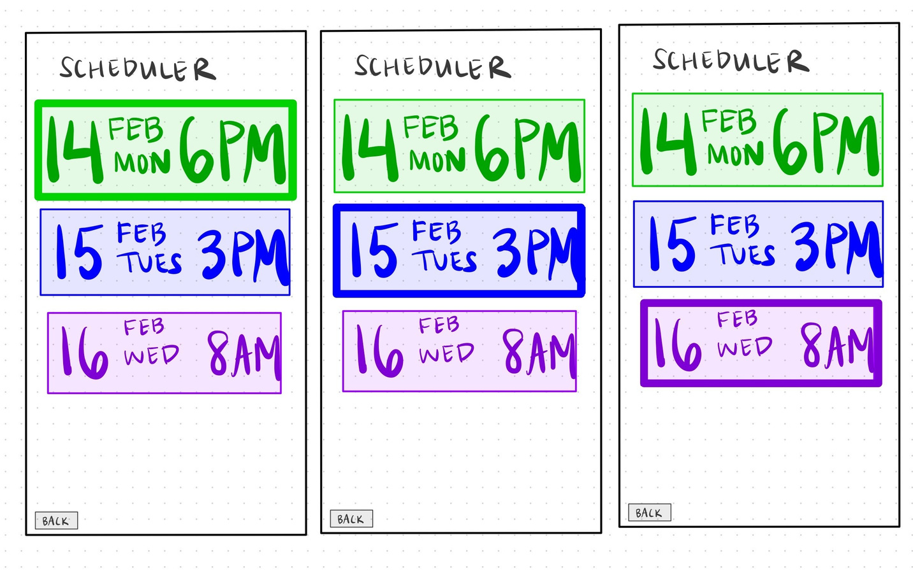
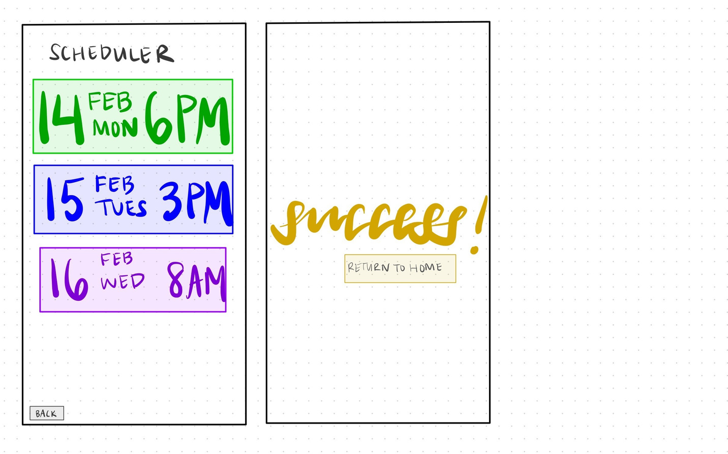
Browse & Select Fitness Classes
SCHEDULE CLASSES

Slide 17
VR Prototype
TASK 2:
BUILD MOTIVATION AND COMMUNITY

Slide 18
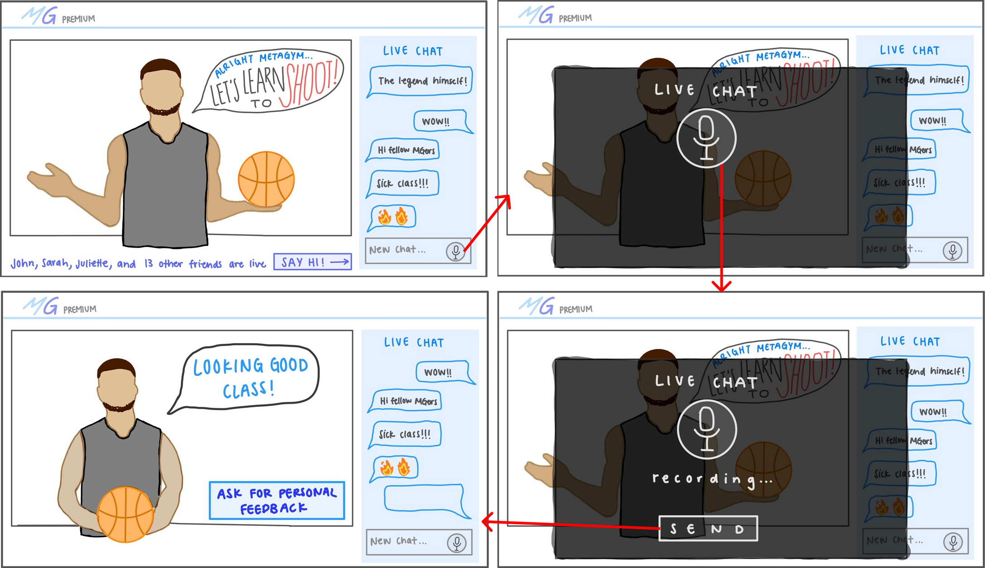
Build Motivation and Community

Slide 19
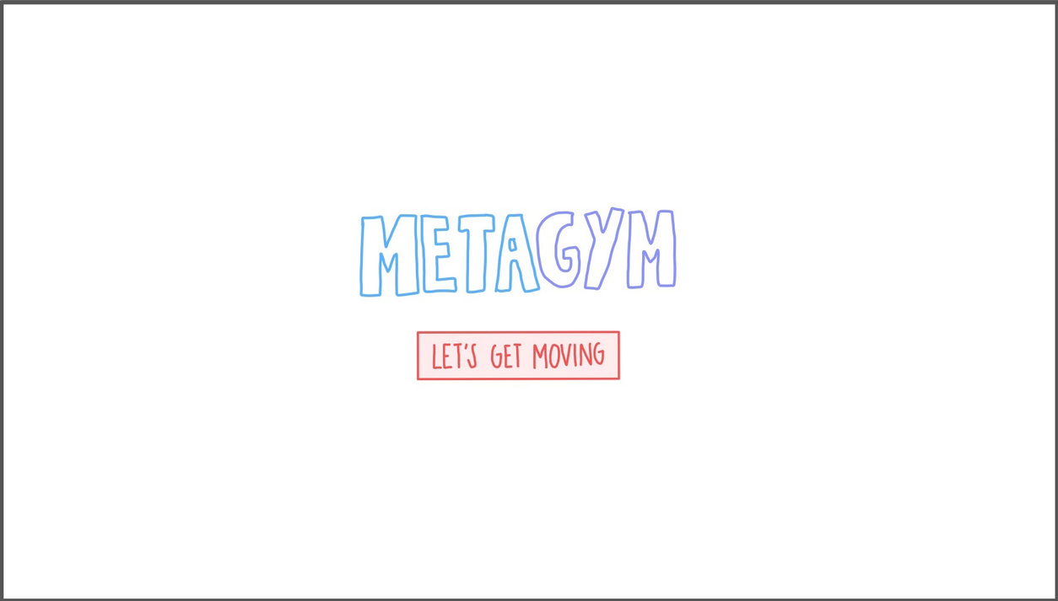
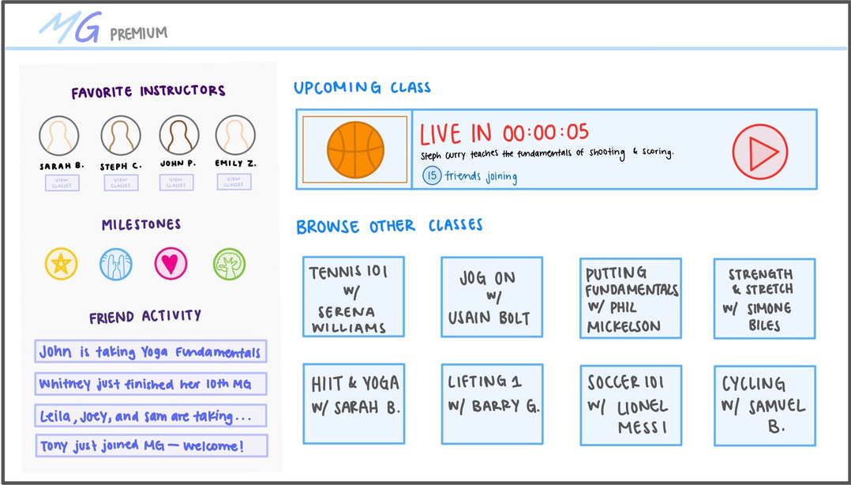

Build Motivation and Community
ENTER VR PLATFORM

Slide 20
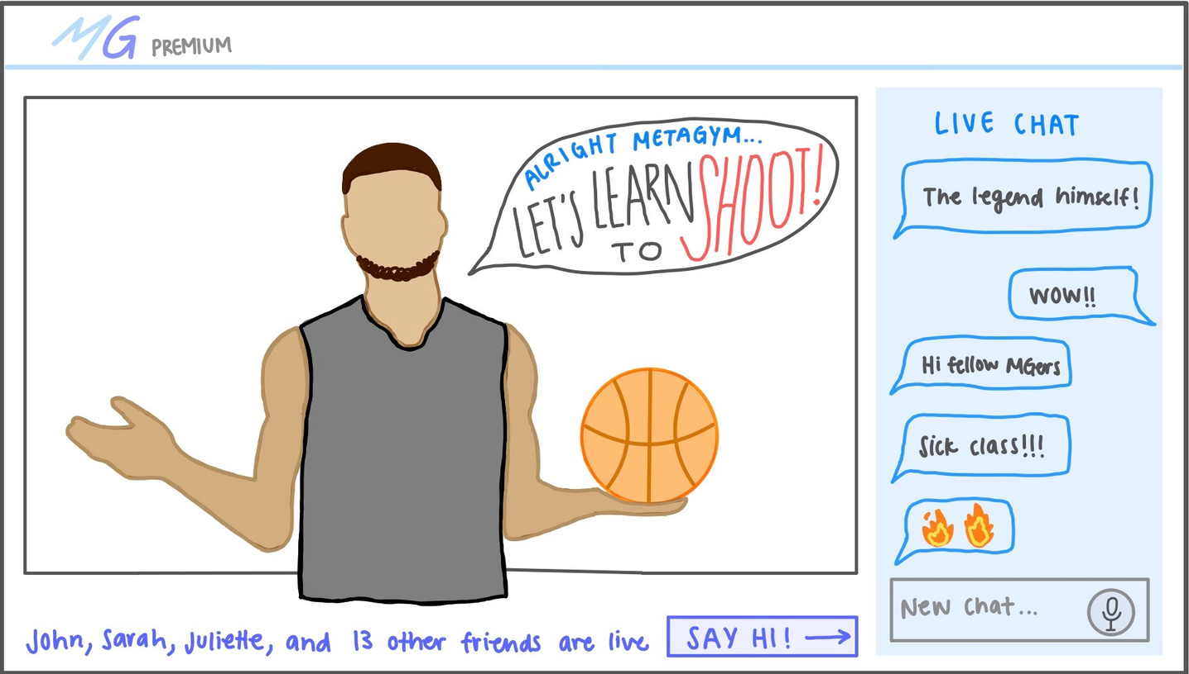
Build Motivation and Community
JOIN LIVE CLASS

Slide 21
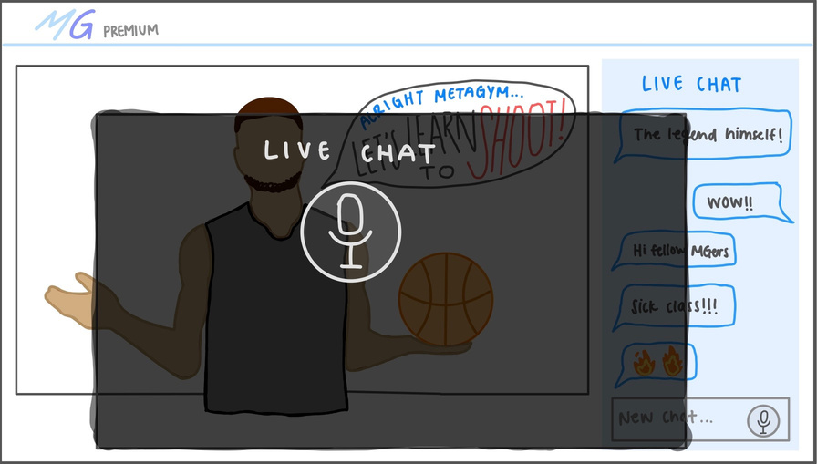
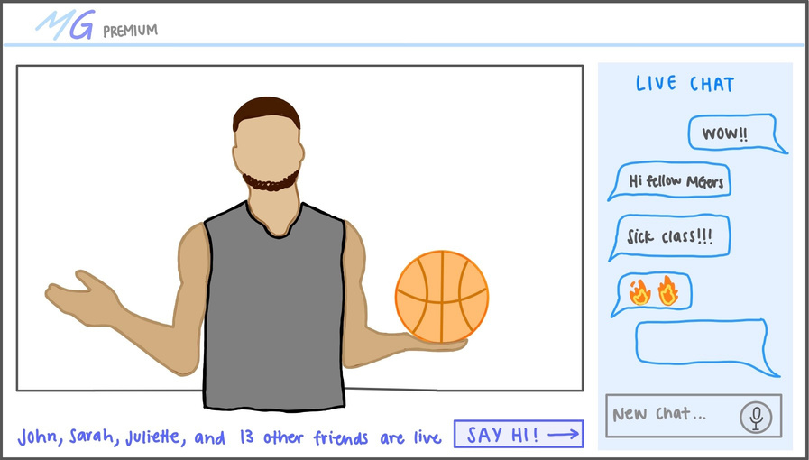

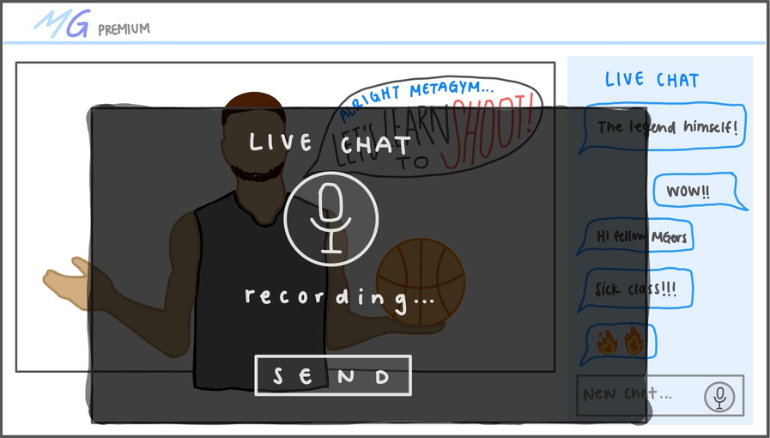
Build Motivation and Community
SEND CHAT VIA VOICE RECOGNITION

Slide 22
VR Prototype
TASK 3:
RECEIVE INSTRUCTION FROM
INSTRUCTOR

Slide 23
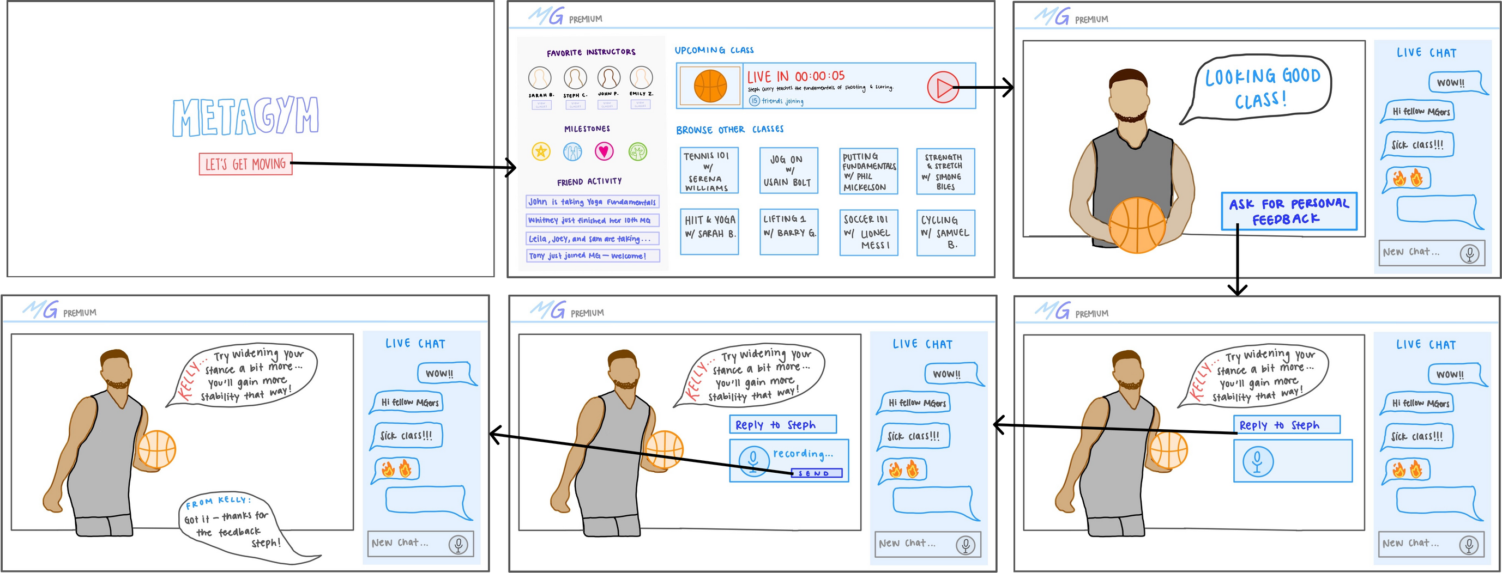
Receive Instruction from Instructor

Slide 24
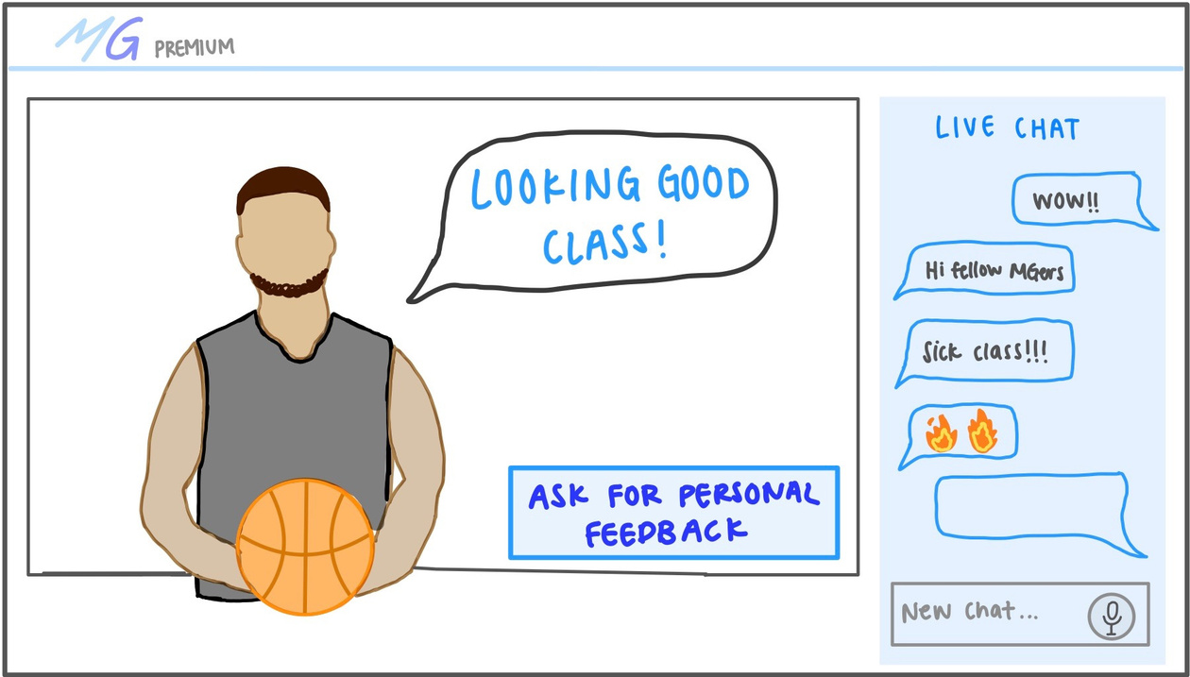
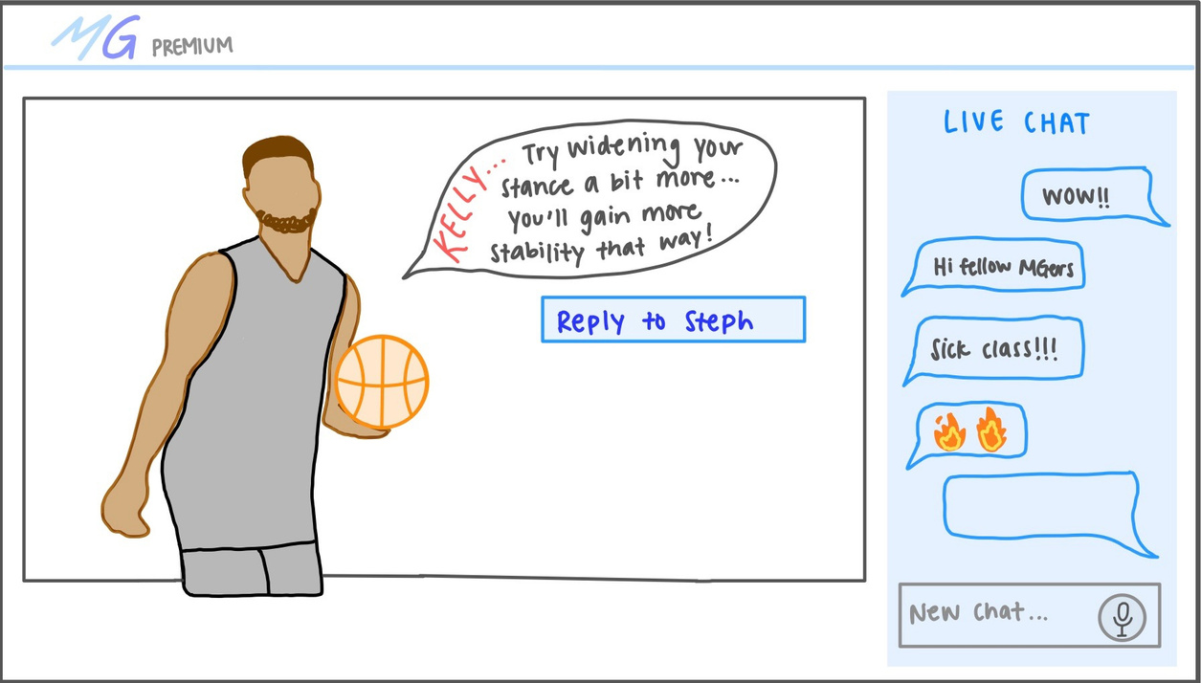
Receive Instruction from Instructor
REQUEST PERSONAL FEEDBACK

Slide 25

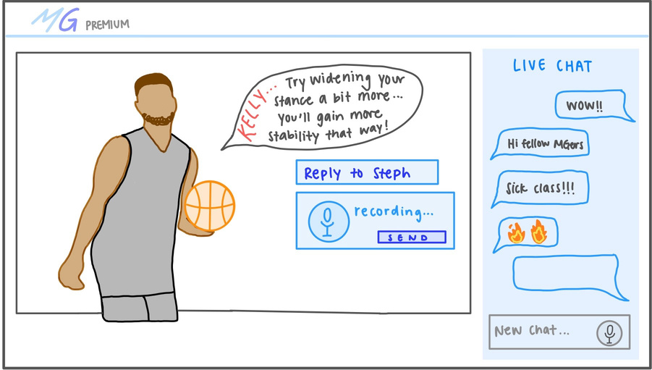
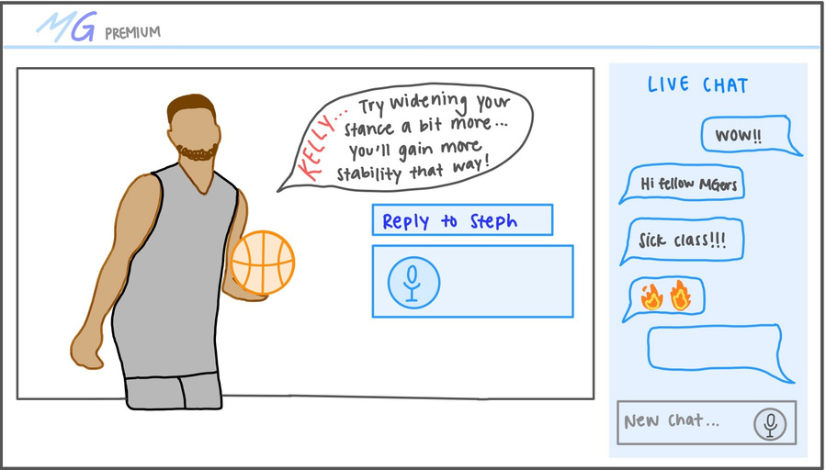
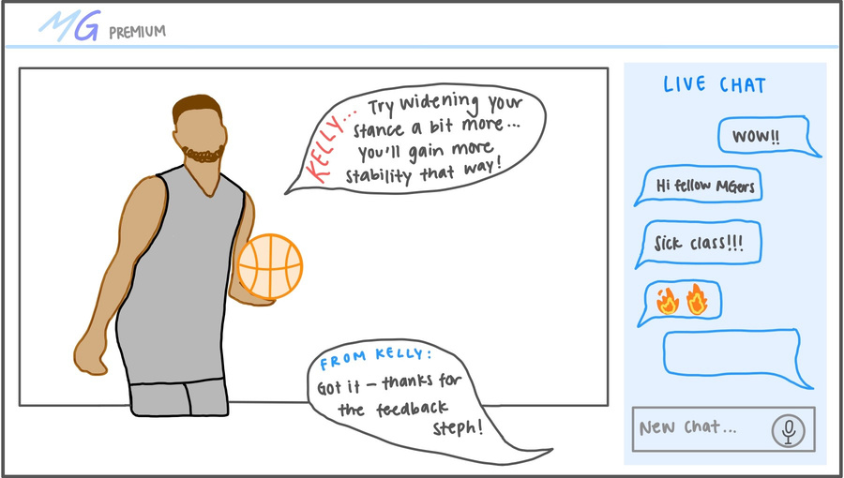
Receive Instruction from Instructor
REPLY TO INSTRUCTOR VIA VOICE

Slide 26
Interview Process
Facilitator asks participant relevant follow-up questions
Participant provides commentary while completing tasks and facilitator takes notes
Participant shares screen and completes tasks
Facilitator gives introduction, demo on InVision and Adobe XR, and tasks

Slide 27




PARTICIPANT OVERVIEW
PARTICIPANT 1
PARTICIPANT 2
PARTICIPANT 3
PARTICIPANT 4
- 21 year female @ Brown
- from Atlanta, GA
loves lululemon workout gear and design!
-42 year old mother of 2
-homegrown Palo Alto
-20 year old female from Binghamton
University
-doesn't like working out
-30 year male from Nashville, Tennessee
-moderately works out
- arbitrarily recruited from SoulCycle class
-recruited from a mutual friend
-recruited from a mutual friend
-recruited from a mutual friend

Slide 28
Page 6
EXPERIMENTAL RESULTS

Slide 29
RESULTS: SUCCESSES
VOICE
NAVIGATION
Felt intuitive to use voice rather than having to type while working out
Able to successfully navigate through all screens without major intervention
VR PROTOTYPE UI
DESIGN
Loved the interactivity of the 3D UI
Loved the fun colors, circular buttons, and the handwritten font

Slide 30
QUOTE - SUCCESS
“I like that it’s a voice message because I can’t really type while working out”
- PARTICIPANT 1

Slide 31
RESULTS: ERRORS
SCHEDULING THE CLASS
LIVE CLASS
Testers were confused because they thought they had already scheduled the class after confirming an instructor. There were also no details shown about the selected class after confirming.
The VR UI was cluttered with lots of buttons and text, which made it difficult to find the join class button
AUDIO TRANSCRIPTION OR TEXT?
EXIT CLASS
Participants weren't sure if they should speak into the mic or if there was supposed to be a keyboard to text during the live chat task. One participant noted it would be a 'hassle' to keep up with the live chat while working out.
There was no way to exit a live class after the class was over

Slide 32
QUOTE - WISH
“It would be nice if we got to see a summary of our schedule on the success page.”
- PARTICIPANT 3

Slide 33
QUOTE - CONSIDERATION
“How can I turn my avatar cam/mic off if I want a water break?"
- PARTICIPANT 1

Slide 34
SUGGESTED UI CHANGES
CLASS SCHEDULER
LIVE CLASS
The wording should be changed to "select instructor" to prevent confusion. Details about scheduled classes should also appear somewhere, and there could also be a Google Calendar event function.
The VR homepage should only have the most important details, and the button to join a live class should be big and obvious with a text label.
AUDIO COMMUNICATION
EXIT CLASS
Rather than having a chat with voice-to-text communication, it may be better to simply have a microphone on/off button and allow users to chat live through voice.
There should be a button to exit a class and return to the homepage at any time.

Slide 35
Ensure seamless transitions between different task flows
1.
2.
Sharpen the clarity of UI function
IN SUMMMARY
WE WILL NEED TO...
3.
Simplify the UI

Slide 36
Chloe
Melinda
Shimea
Rachel
VR/AR X EDU - TEAM 5
CS 147 - Assignment #5
B
I
U
Thank you!
- MetaGym

